Slide 1





CHURN PREDICTION
USING ML
PRESENTED BY:
SHRIJAN POUDEL SHUBHAM DAWADI RIZAN KHANAL
UTKARSH SHRESTHA PASHUPATI SAH
PRESENTED TO:
SOURAV KUMAR GIRI

Slide 2
CONTENT
01
INTRODUCTION
02
PROBLEM STATEMENT
03
EXISTING SYSTEM CHALLENGES
04
SAMPARK: A SOLUTION
05
CONCLUSIONS AND TAKEAWAY
06
REFERENCES

Slide 3
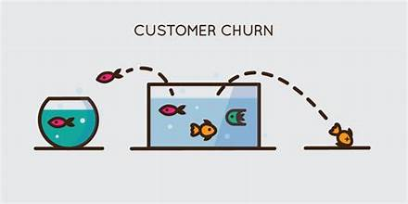
INTRODUCTION
Churn is the rate at which customers discontinue their relationship with a company within a given timeframe. It's a crucial metric for businesses, directly impacting revenue and growth. By analyzing churn, companies can identify trends, patterns, and reasons behind customer attrition. This analysis enables businesses to implement strategies for customer retention, product/service improvement, and enhanced customer experience. Churn serves as a key indicator of customer satisfaction, loyalty, and overall business health. Effectively managing churn is essential for sustaining growth and maintaining a competitive edge in the market.

Slide 4
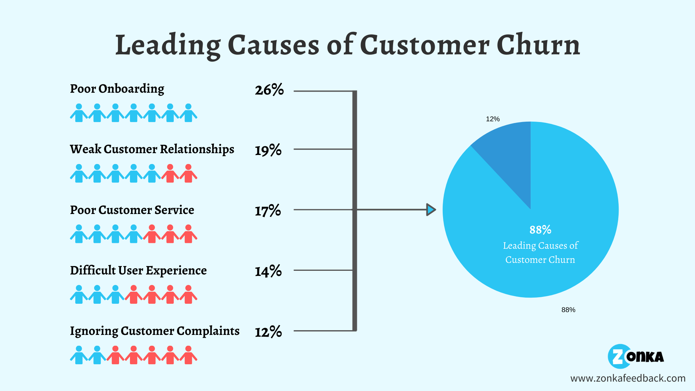
PROBLEM STATEMENT
The SaaS companies are facing challenges in retaining customers, leading to a decline in revenue and market share. The companies wants to implement a proactive approach to reduce customer churn by identifying customers who are likely to churn in the near future. To address this problem, the company seeks to develop a machine learning-based predictive model that can accurately forecast customer churn.
.

Slide 5

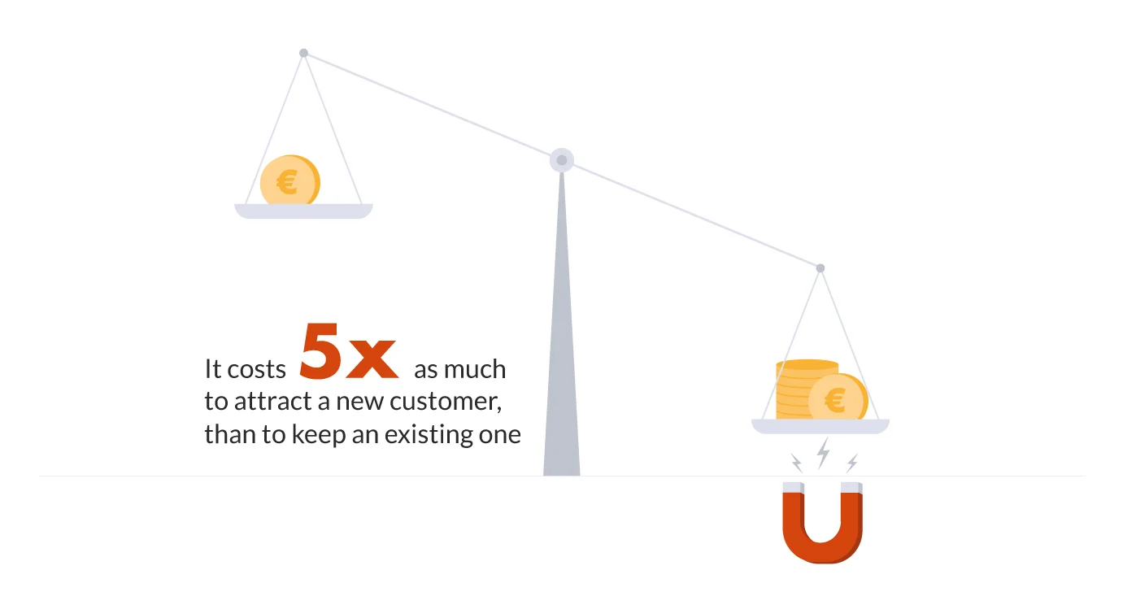
EXISTING SYSTEM CHALLENGES
MODEL DEPLOYMENT AND MONITORING
No proper web app for new businesses through which they can predict their churn rate .
SMALL BUSINESSES STILL NOT FAMLIER WITH CHURN RATE
Small and new businesses face difficulty in understanding why custemers churn.

Slide 6


SAMPARK: A SOLUTION

Slide 7
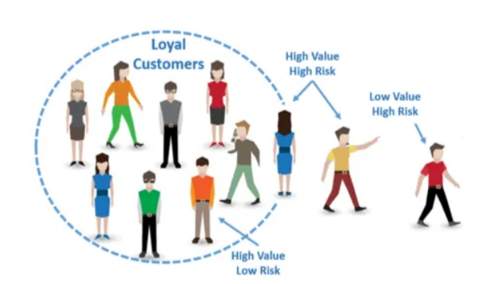
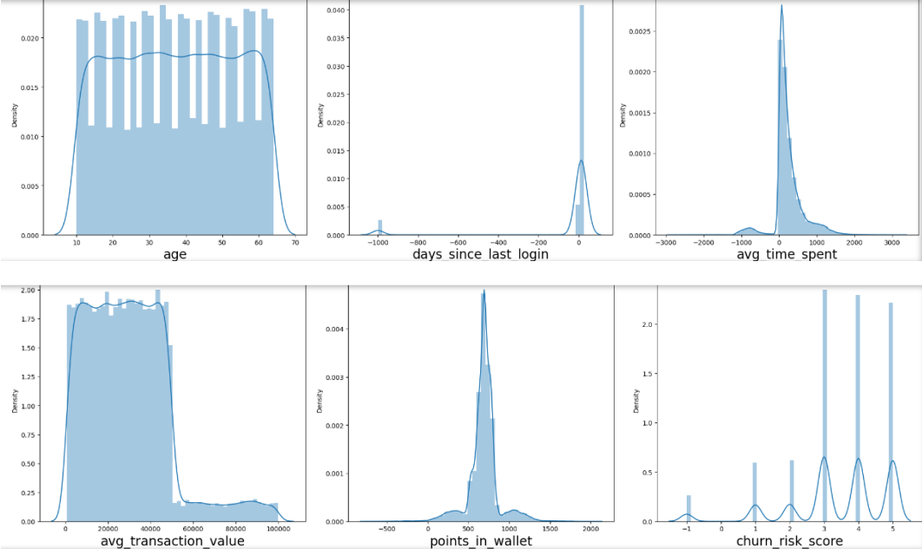
HOW IT WORKS:
Loading and Exploring the Datasets
Utilizes Data for churn prediction
Exploratory Data Analysis (EDA)
Data distributions were analyzed to gain insights into the characteristics of features and their potential impact on the target variable.

Slide 8

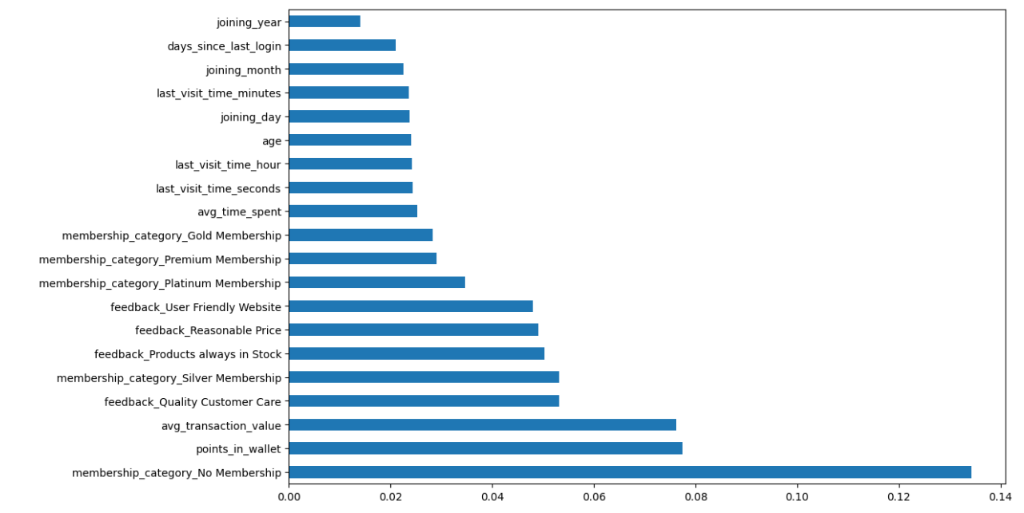
Feature Selection
Extra Trees Regressor was employed to identify important features with significant impact on the target variable.
Training Multiple Models
Decision Tree Classifier
Random Forest Classifier
XGBoost Classifier
Support Vector Machine
Logistic Regression

Slide 9
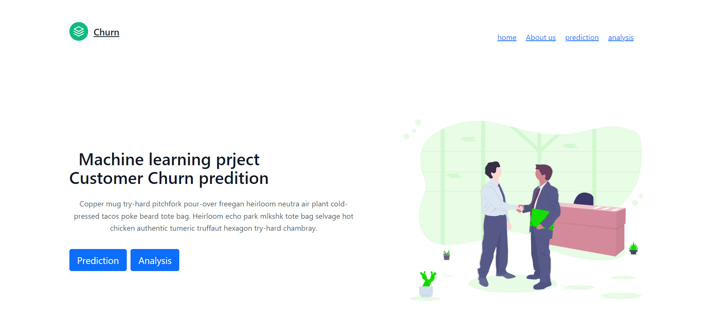
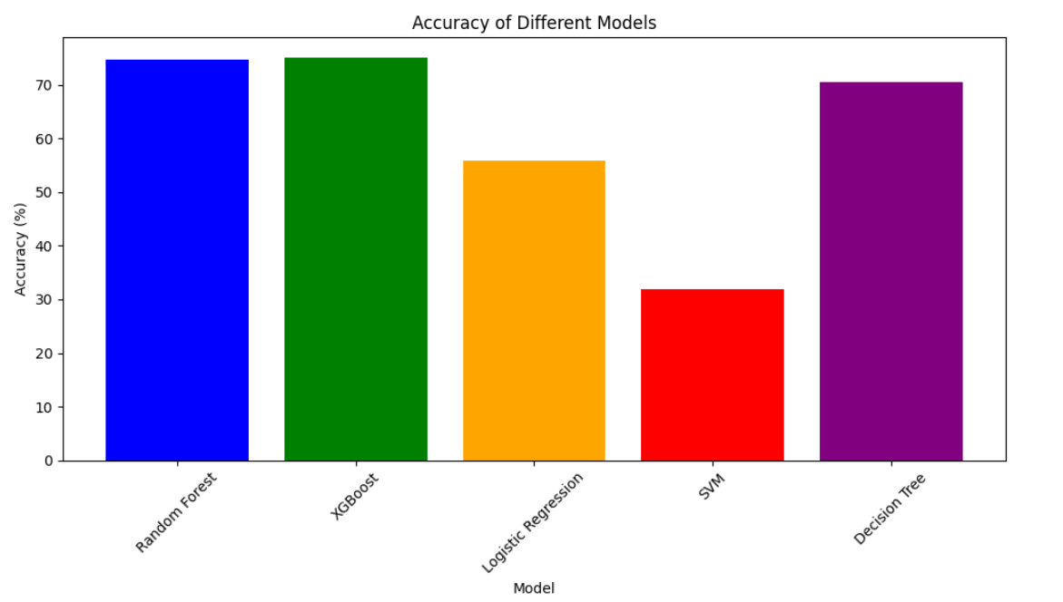
Evaluating Model Performance:
We checked the accuracy of all 5 training models
Web app creation and deployment
Firstly we saved the Final Trained XGBoost Model and deployed it in web server through the pkl file generated

Slide 10
ADVANTAGES OF SAMPARK
Identifying at-risk customers
Improved customer retention strategies
Increased revenue
Data-driven decision making

Slide 11
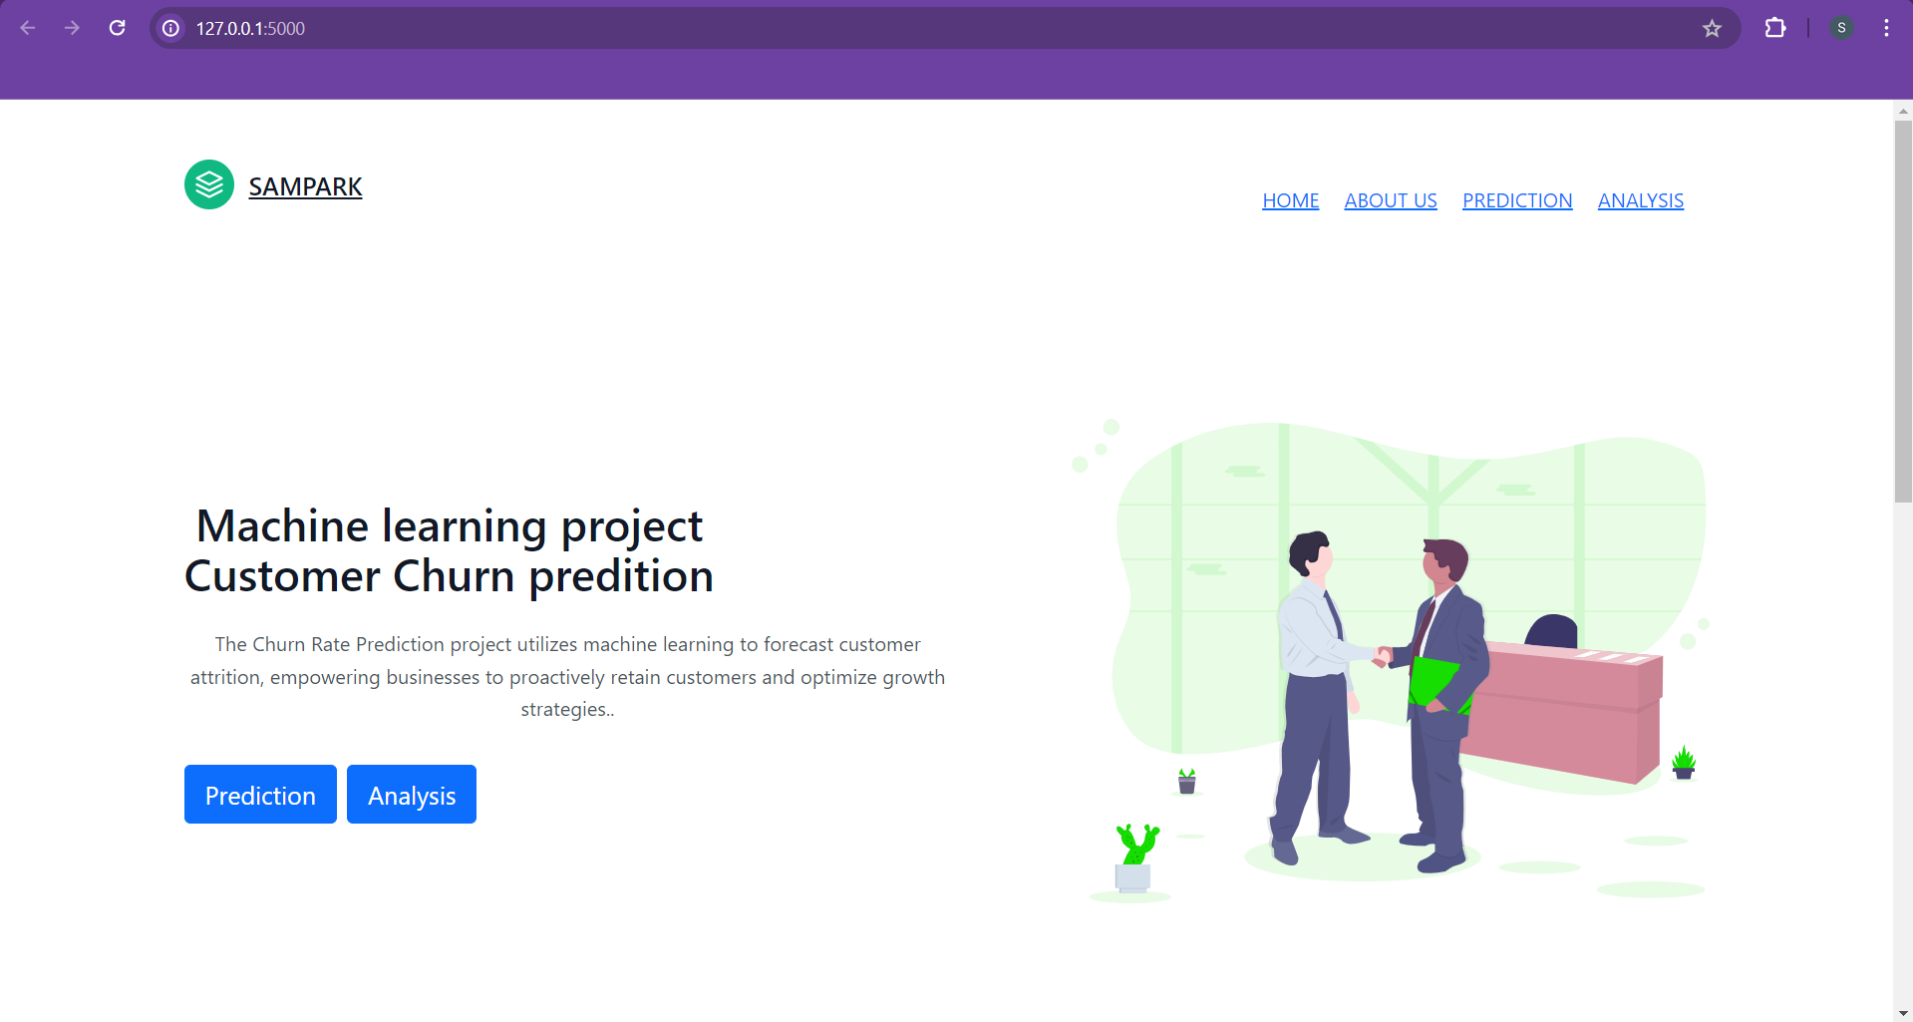
UI OF OUR WEB APPLICATION
MAIN PAGE OF OUR WEBSITE
MADE WITH HTML , CSS ,TAILWIND,BOOTSTRAP

Slide 12
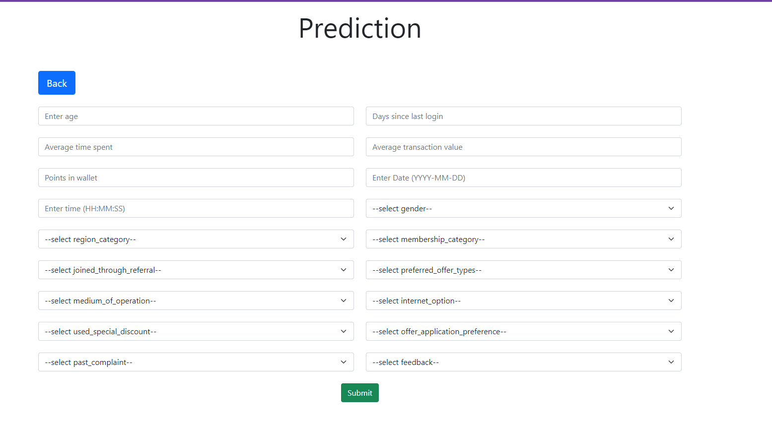
PREDICTION PAGE : FORM SUBMISSION

Slide 13
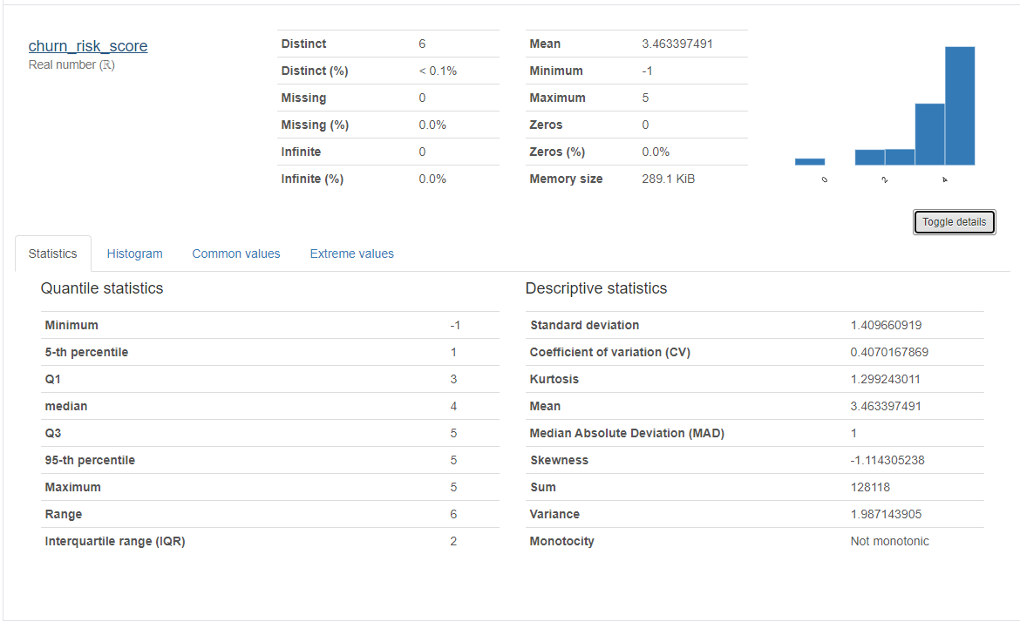
ANALYSIS PAGE FOR OUR CHURN MODEL
INCREAED REVENUE
DATA-DRIVEN MANAGEMENT:
DRECRESES COST FR NEW CA
ENHANCE CUSTOMER RETENTION

Slide 14
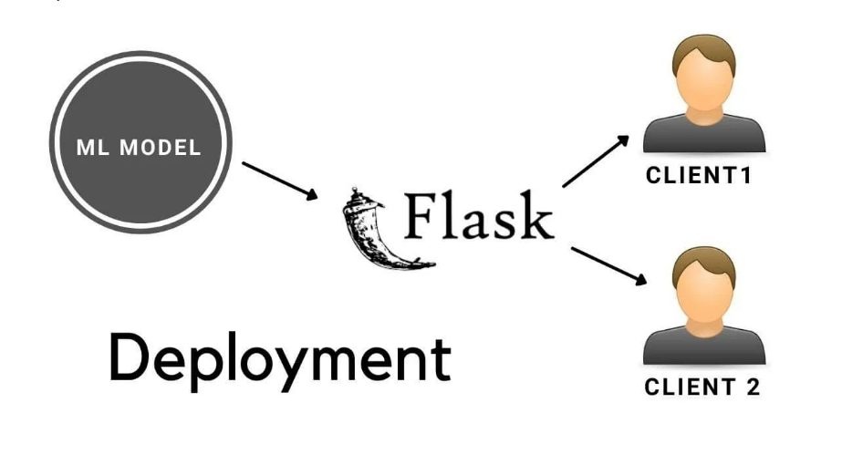
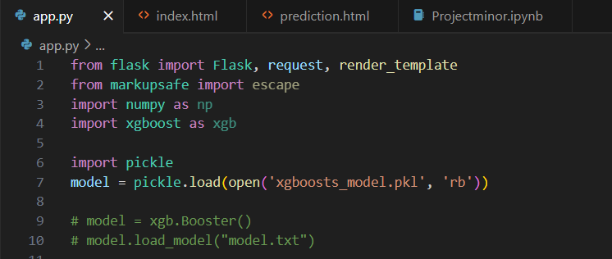
CODE SNIPPET FOR OUR FLASK APPLICATION : LOADING MODEL ONTO FLASK APPLICATION
DATA-DRIVEN MANAGEMENT:
DRECRESES COST FR NEW CA
ENHANCE CUSTOMER RETENTION

Slide 15
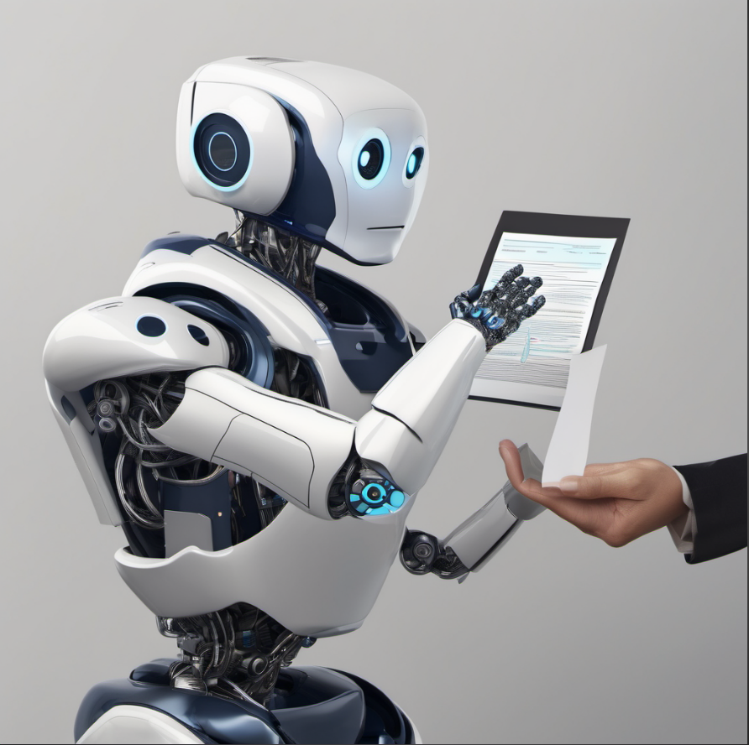
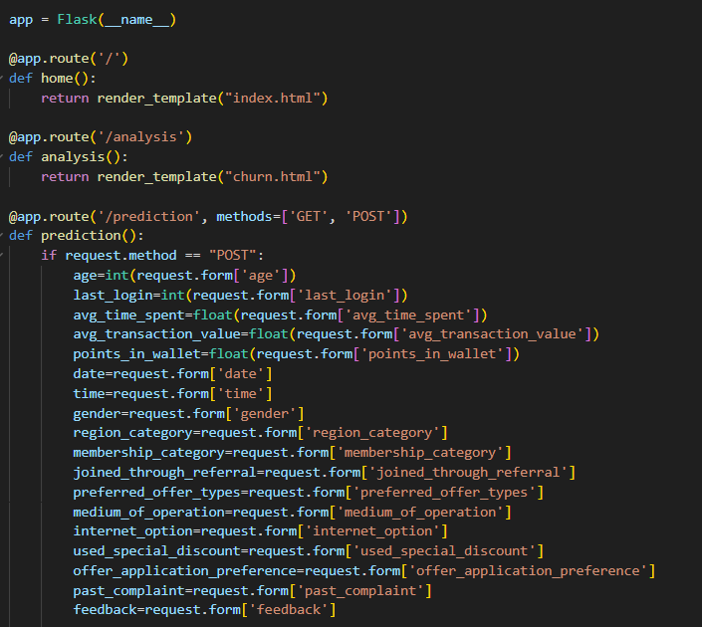

CODE SNIPPET FOR OUR FLASK APPLICATION : FORM SUBMISSION
DATA-DRIVEN MANAGEMENT:
DRECRESES COST FR NEW CA
ENHANCE CUSTOMER RETENTION

Slide 16





INCREASED REVENUE
DATA-DRIVEN MANAGEMENT:
DRECRESES COST FOR NEW CA
SAMPARKA ENHANCES
ENHANCED CUSTOMER RETENTION

Slide 17
CONCLUSION
In conclusion, our analysis demonstrates the efficacy of machine learning in predicting churn. By identifying key factors influencing customer attrition and deploying robust models, we can proactively address churn risk. Moving forward, implementing targeted retention strategies and fostering cross-functional collaboration will be paramount for maximizing customer retention and business growth.

Slide 18
FUTURE SCOPE
Enhanced Data Integration: Future churn prediction models will integrate a wider array of data sources, including social media activity, IoT data, and more, for a comprehensive understanding of customer behavior.
Advanced Algorithms: Continued advancements in machine learning algorithms, such as deep learning and ensemble methods, will enable more accurate churn prediction by identifying intricate patterns in data.
Explainable AI: Improved explainability techniques will offer insights into why customers churn, enabling businesses to take proactive measures to address underlying issues.
Real-Time Intervention: Integration with real-time data streams will facilitate immediate intervention strategies, allowing businesses to prevent churn before it happens.

Slide 19
REFERENCES
https://userpilot.com/blog/churn-prediction/#:~:text=Churn%20prediction%20involves%20identifying%20at,make%20predictions%20about%20new%20customers.
https://medium.com/@adam.fard/churn-analysis-101-c072bb91af08
https://www.analyticsvidhya.com/blog/2021/08/churn-prediction-commercial-use-of-data-science/

Slide 20

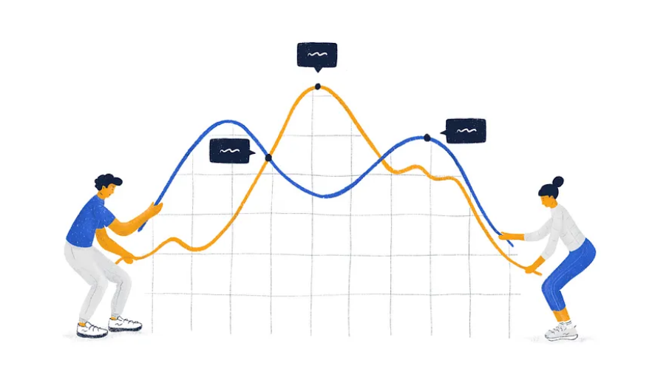
TEAM : SAMPARK

